Slide 1
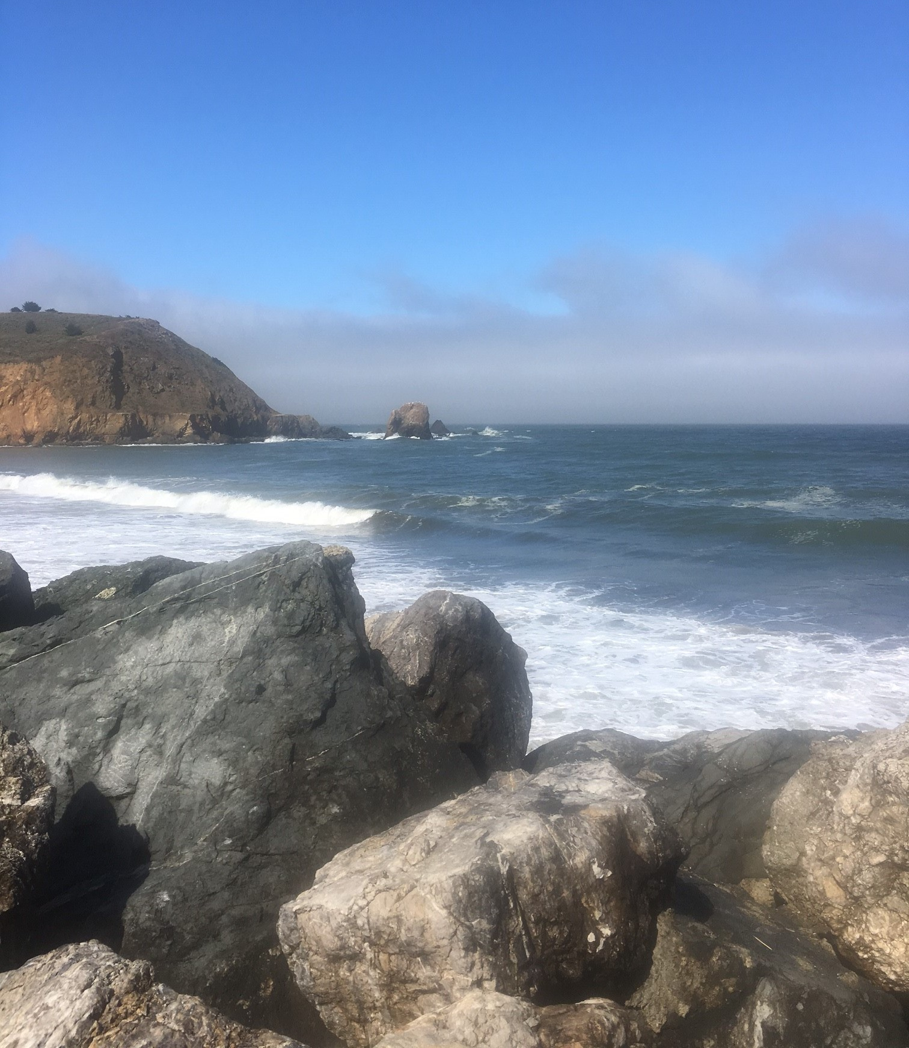
Keeping your sanity in the insanity
Stephen navyac
Sara Hamill
Steve emley

Slide 2

What makes touring life unconventional?
Unpredictable schedule
Job insecurity or change
Family/spouse/partner relationship strain and distance
Adapting to road “family” personalities and dynamics
Variation of each work day/venue
Struggle to make long-term goals and plans
Unconventional management; dynamic of “proving yourself” daily
Difficulty of forming meaningful and genuine relationships

Slide 3

What are your top struggles with touring life?
Write a question, thought or idea on an index card and we will talk about these as a panel.

Slide 4

Reflection questions
The definition of insanity is doing the same thing over and over and expecting a different result….what are you doing over and over that isn’t yielding the result you’re looking for?
What do you wish was different about your job/position/personal life/road life?
How are you doing managing your stress, relationships, conflict, lifestyle, emotions, job duties?

Slide 5

Suggestions for a healthier life
Accept that disillusionment is a normal part of this and any job. At first it seems glamourous and then reality sets in.
Identity: this work is not who you are. Who are you outside of your touring work? What truly defines you?
Emotional Integrity: What is real relational intimacy? How can you stay stable? Patrick Carnes defines intimacy as requiring initiative, nurturing, honesty, presence, completion, vulnerability.

Slide 6
Suggestions for a healthier life
Spiritual Life: What keeps you grounded and connected? What guides your sense of integrity, truth, courage?
Relational Life: How do you manage your relationships? How do you manage “integrating” from touring life to everyday life? Do you need some additional help with relationships? Counseling? Support groups?
Financial Concerns: Do you need help managing and planning with money?

Slide 7

Find your rhythm on the road
Set small achievable goals: loose weight, eat better, read, collect things
Establish a routine: journal, stretch, read, nap, pray, exercise
Keep healthy: wash hands, eat well, rest, vitamins, community, doctor/dentist visits, physical comfort
Process the stress/drama from work in a healthy way; do your emotional work
Mental outlets: hiking, being outside, meditation, counseling, mentoring, support groups/12Step groups, supportive relationships, being alone

Slide 8

Increase your resources
Emotional:
Counseling
Support groups
Reading
Trauma treatment (EMDR)
Conflict resolution skills

Slide 9
Increase your resources
Spiritual:
Counseling
Support groups
Reading
Coaching/Spiritual Director
12 Steps
Missional or volunteer work

Slide 10
Increase your resources
Mental:
Counseling
Reading
Additional higher education or skill-building
Artistic projects outside of touring
Side business
Future career plans
Financial planning

